Slide 1


Participative and Collaborative Policy Maturity Model: Institutionalisation Challenges
Dr. Agnė Paliokaitė
8 June 2016

Slide 2

Two challenges
Of the three Open Government objectives, Participation and Collaboration receive less policy attention, compared to Transparency (survey by Lörincz et al, 2011).
Institutionalisation of participative processes - maintaining and enforcing governance openness over time and throughout the policy cycle.
Strong:
Systemic, regular tools and platforms at all levels (national-municipal).
Institutions, responsibilities and legal basis in place.
People, resources, capabilities.
Monitoring and evaluation.
Incentives (and sanctions).
Weak:
Ad hoc, occasional.
No systems (people, institutions, regulation, capabilities) in place.

Slide 3
Collaborative & Participative Policy Maturity Model: from Government action to Community action
 | Role | Tools and platforms
6. Co-delivery | Shared actions (We are responsible and accountable) | Co-delivery of public services Social innovations. Living labs. Pilot testing of policy prototypes.
5. Co-creation | Self-mobilization, shared decision making (We decide) | Participative policy making exercises involving variety of methods, focused on future needs and trends (foresight). Policy labs.
4. Engagement | Functional participation (We talk and understand each other) | Participative technology assessments (some) Expert groups, committees. Open Citizens forums, Policy discussions
3. Consultation | Information exchange (Information in – information out) | (some) Expert groups Referendums Online public consultations Customer feedback
2. Informing of decisions | Passive participant | Formal presentations
1. Intuitive representation | Casting a vote | Elections

Slide 4
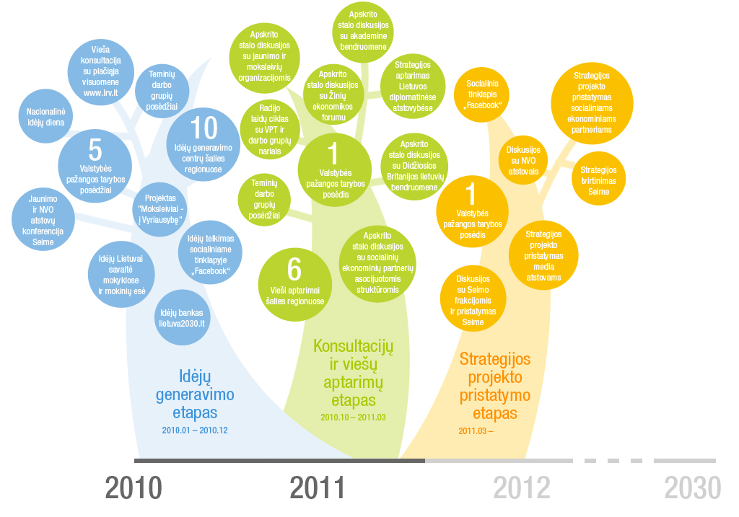

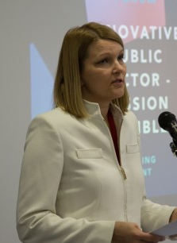


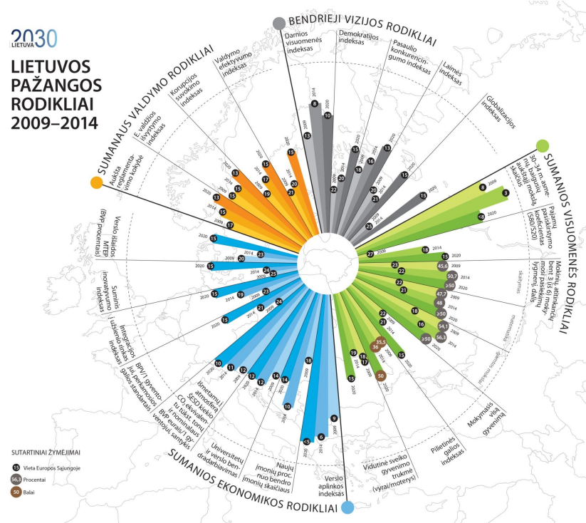
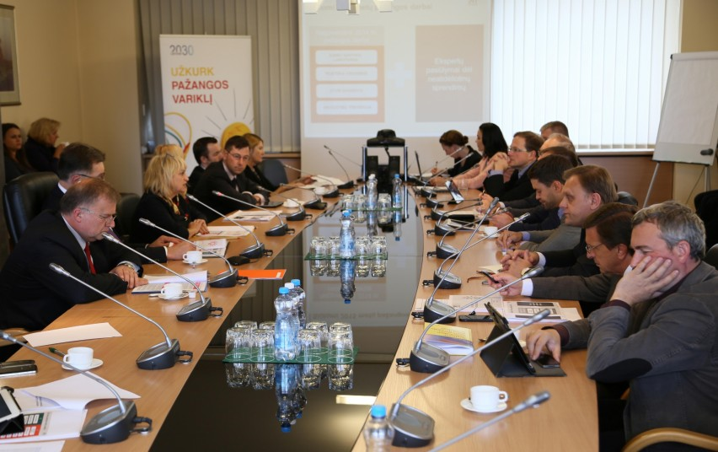
Case study: Lithuania
First time citizens involved in the design of a long term vision: 2-year process 3 stages: ideas generation, consultations, discussions on draft Strategy Implementation system: Open Progress Forums (2/y) Good Practice Library State Progress Council and its Secretariat at the Government’s Office Annual Progress Actions – ‘quick wins’ Annual Progress Report Progress indicators

Slide 5
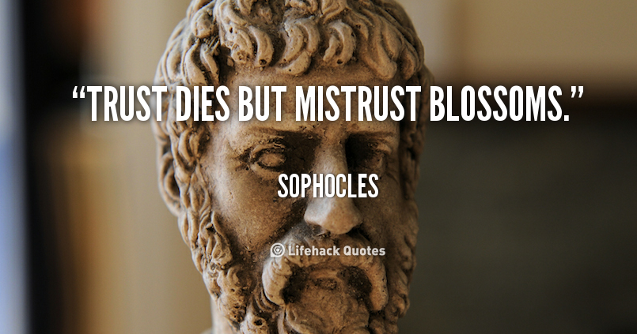
Institutionalisation challenges
KEY RISKS TO CONSIDER:
‘Old wine in new bottles’
+ ‘Grand rise but slow death’
= losing society’s trust
Struggles of a pioneer: Prevailing (maturity of) governance culture. Competencies for facilitating new types of stakeholder interaction.
Detachment from implemented decisions:
Vision papers have weak implementation power.
Fading political drive as Governments change.
Administrative institutionalisation and resources.
Challenges to empower mainstreaming of best practices.
High supply of ideas for „quick wins“, but lacklustre implementation.
Limited feedback to the society on what happened to their ideas.
Instruments for monitoring citizen engagement.

Slide 6
Lessons
1.Leadership and commitment of key opinion leaders
2. Quality and variety of engagement at design stage
8. Professional information campaigns on the new functions, mandate
7. Development of communities of practice
4. A strong administrative core, capable to steer other stakeholders
3. Skills and capacity development to commission, design, conduct, manage, and use the tools
6. Legislation, administrative directives, well-defined procedures, methodologies
5. Permanent stakeholder involvement platforms and tools

Slide 7


Thank You!
Dr. Agnė Paliokaitė,
Visionary Analytics
Agne@visionary.lt
www.visionary.lt

