Slide 1

The Commission for Future Generations in the Israeli Parliament
Lessons learnt
Judge (ret.) Shlomo Shoham
Former Commissioner for Future Generations
The Israeli Parliament

Slide 2
Lessons learnt
Foresight beyond forecasting.
Sustainability unit and assimilation unit.
From surviving mode to future creation mode.
Future oriented Leadership – the challenge.

Slide 3
Future Oriented Leadership
Judge (ret.) Shlomo Shoham
Former Commissioner for Future Generations
The Israeli Parliament

Slide 4
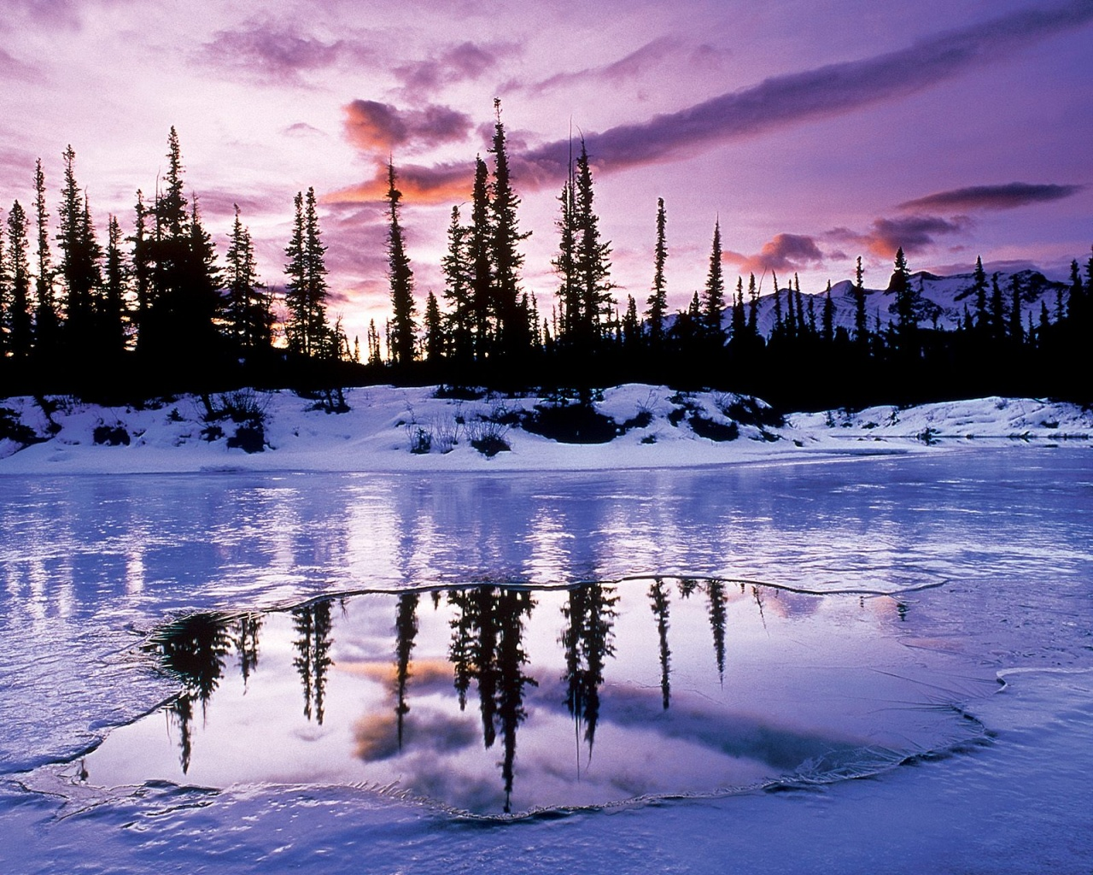

Slide 5
Who are you?
What do you want?
Where are you going?
Personal / Social / Global

Slide 6
Future Intelligence
Future Intelligence : is the human and social ability required to fashion and implement a desirable future,
for humanity and all of biological diversity, and for the world.

Slide 7
Leadership in Survival Mode
Facing Future with Anxiety
Withdrawal, Rigidity
Breaking Away from Core Values
Resisting Change
Short Term Thinking
Reactivity, Lack of Initiative
Future Shaped by Past Trauma
Victim Mentality
Guilt instead of Responsibility
Lack of Energy for Future Creation
Vicious Circle

Slide 8
Future Creation Mode
The Inner Self
Meaning and Core Values
Courage to Forget , Forgive and Let Go
Flexibility & Adaptability
Dare to Make Mistakes
Future Imagery
Sense of Service
Vision into Action

Slide 9
“A captain who does not know
whither he wishes to sail his ship,
no wind in the world will
carry him there...!"
Lucius Aneus Seneca

Slide 10
Holistic
Awareness
Physical
Intellectual
Emotional

Slide 11
There is a clear correlation between the ability to
create a vision of the future
and the
success in
actualizing these ambitions.
(Polak)

Slide 12
Human development
is strongly affected by
hopes
and
future expectation.
(Cornish, Kuhn and Plante)

Slide 13
Who am I ?
What do I want?
Where am I going?
Personal / Social / Global

