Slide 1

The European Parliamentary Technology Assessment (EPTA) Network
Public hearing „For the next generations“,
Committee for the Future, Finish Parliament
8 June 2016
Dr. Michael Nentwich

Slide 2
EPTA: Basic information
EPTA = European Parliamentary Technology Assessment
Network, no association, light organisational structure
Currently 18 members (max. 1 per country)
Founded in 1992
Annually rotating presidencies, currently Austria

Slide 3
Membership criteria
Full membership:
operates in Europe (as defined by Council of Europe),
is devoted to TA or related activities,
serves the parliament,
has its own budget and secretariat,
has a competence regarding issues with a scientific and technological component
Associate membership:
one of the above criteria is not met, e.g. doesn‘t operate in Europe
Observer status:
invited by presidency,
failing on more than one of the above criteria

Slide 4
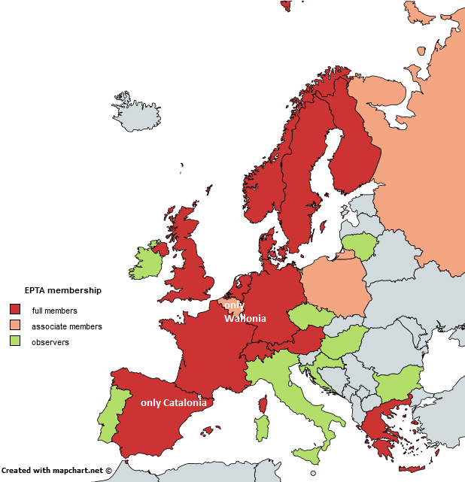

Members and observers in Europe

Slide 5
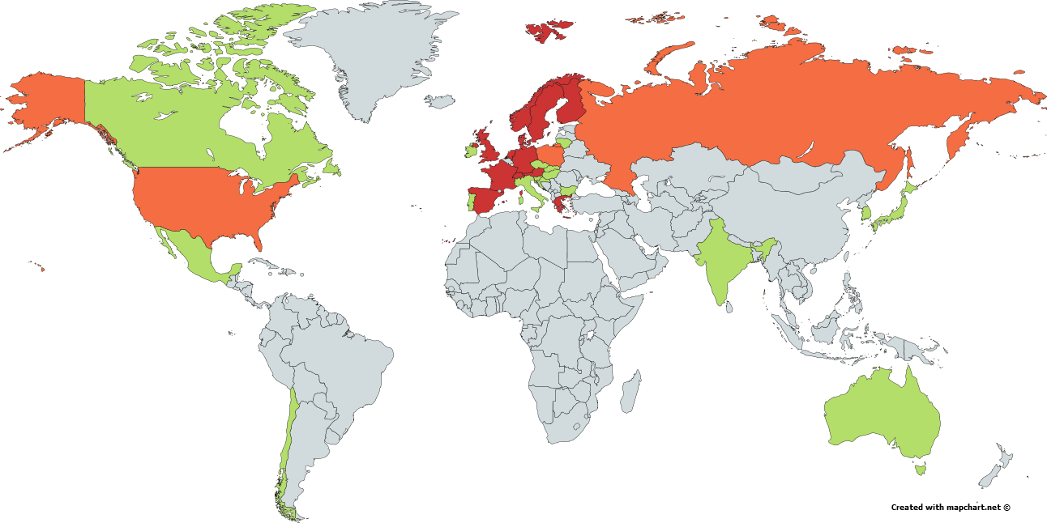
Associate members and observers in the world

Slide 6
Activities
Directors‘ meeting (annual 3-days working retreat in the current presidency‘s country)
Council meeting (annual 1/2-day organisational session in the presidency‘s capital)
Conference (annual 1-day symposium in the presidency‘s parliament)
Practitioners‘ meeting (biannual 3-days working retreat of staff of EPTA members)
Common projects
Annual comparative report on conference topic
Occasional major collaborative project

Slide 7
EPTA projects
The future of labour in the digital era (2016)
Innovation and climate change (2015)
Productivity in Europe and the United States (2014)
Energy transition in Europe (2006)
Genetically modified plants and food (2006-2008)
ICT and privacy in Europe (2004-2006)

Slide 8
EPTA in the Internet
eptanetwork.org
Members‘ profiles
Policy-briefs database
Projects database
News feed
facebook.com/EPTA.Network/
en.wikipedia.org/wiki/European_Parliamentary_Technology_Assessment de.wikipedia.org/wiki/European_Parliamentary_Technology_Assessment
Powered by TA Portal technology-assessment.info

Slide 9
The future of EPTA
Widening?
PACITA impetus: more activities in Europe
Growing interest from all over the world
Deepening?
More exchange (e.g. policy briefs)
More cooperation in public relations
More common projects

Slide 10
Thank you for your attention!
Contact:
Dr. Michael Nentwich
A-1030 Vienna, Strohgasse 45/5
Tel: +43 (1) 51581 6583
Fax: +43 (1) 7109883
Email: mnent@oeaw.ac.at
WWW: www.oeaw.ac.at/ita/en/nentwich

